Slide 1
SmartCar
Tuesday july 9th 2019
Axel Mendoza
Thibaut Barroyer

Slide 2
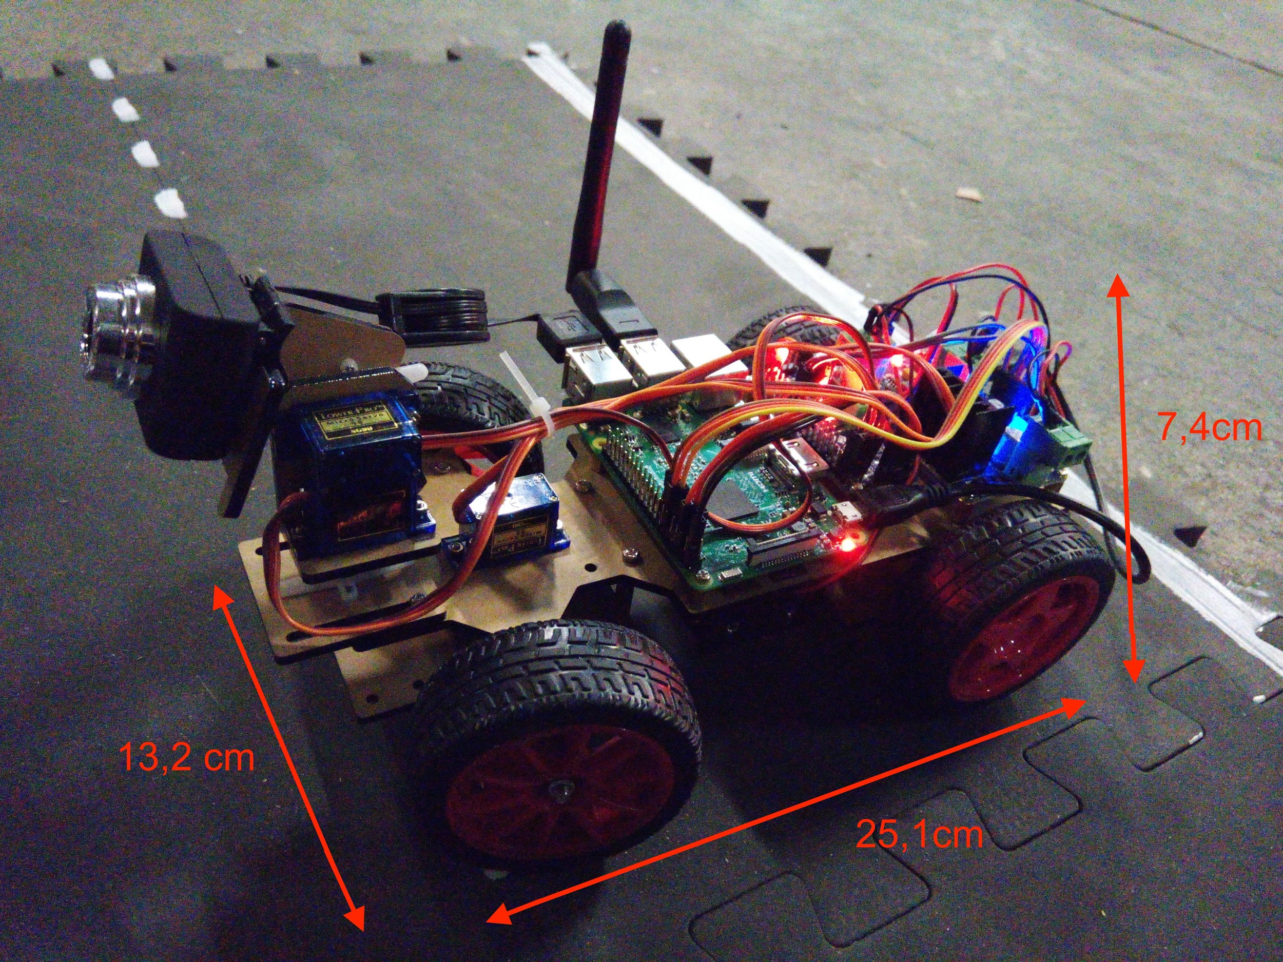
Raspberry Car’s Hardware
13.2 x 25.1 x 7.4 (cm)
800 g
Max speed 2 km/h
3 hour autonomy
Wireless communication
Remote access

Slide 3
Raspberry Car’s Hardware
Raspberry PI 3 equipped with 4 processor cores
Wish-eye camera handeling 15 fps
Ultrasonic sensor with 1m range
Wireless antenna of 300 MBPS

Slide 4
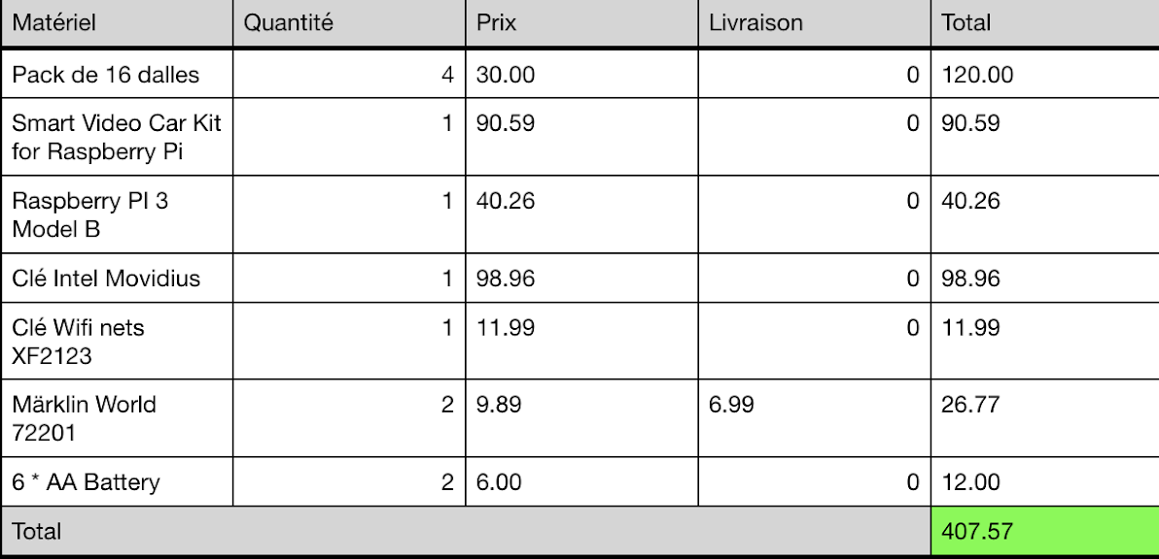
Costs
€

Slide 5
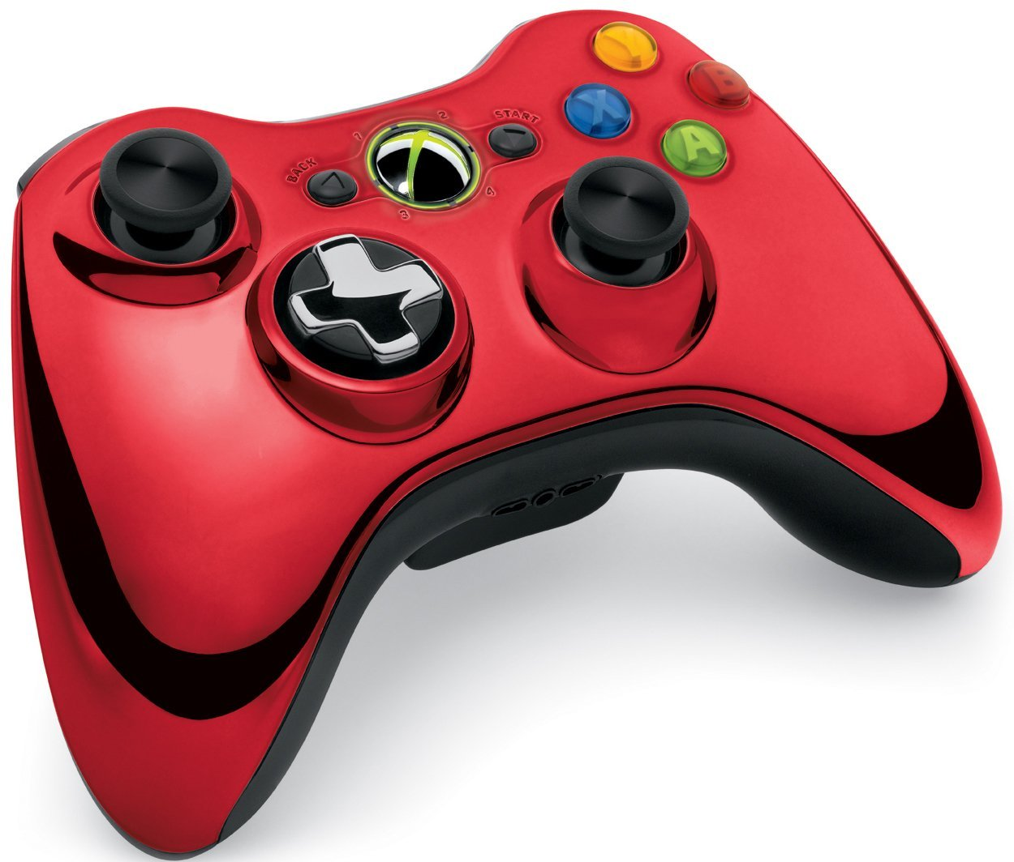
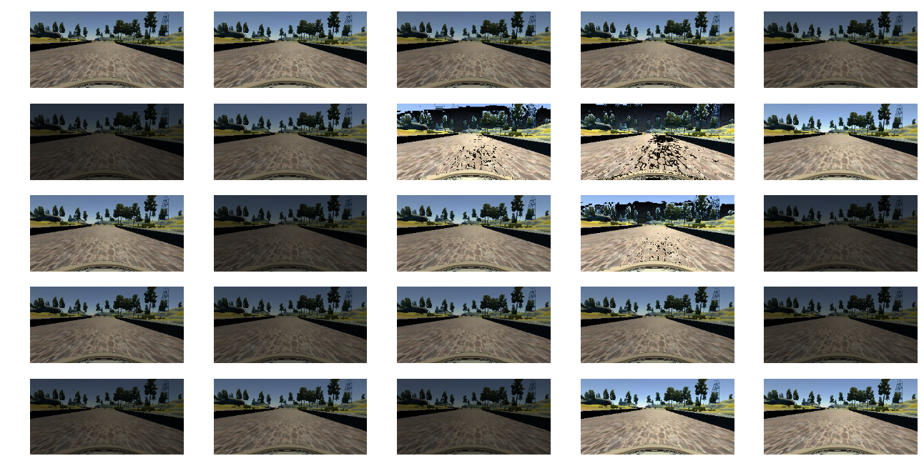
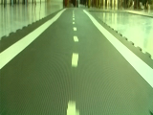
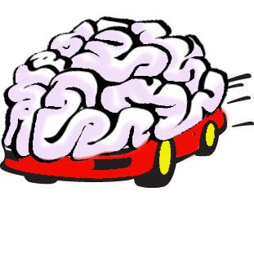
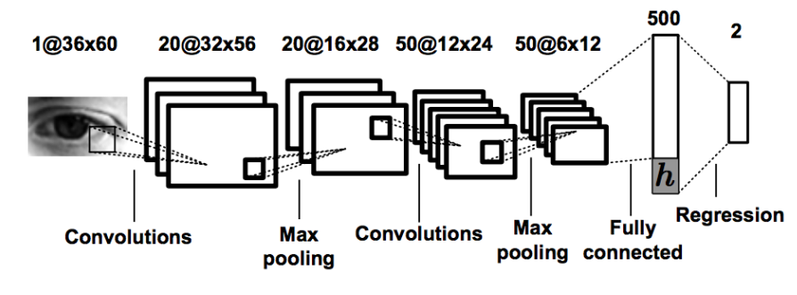
Trajectory Planning Pipeline
Raspberry Car
Generate
Angle/Speed
labeled data
Pre-process
and
augment data
Real-time
Angle/Speed
prediction
Dump model
on
Raspberry Car
Train
Deep Learning
model

Slide 6
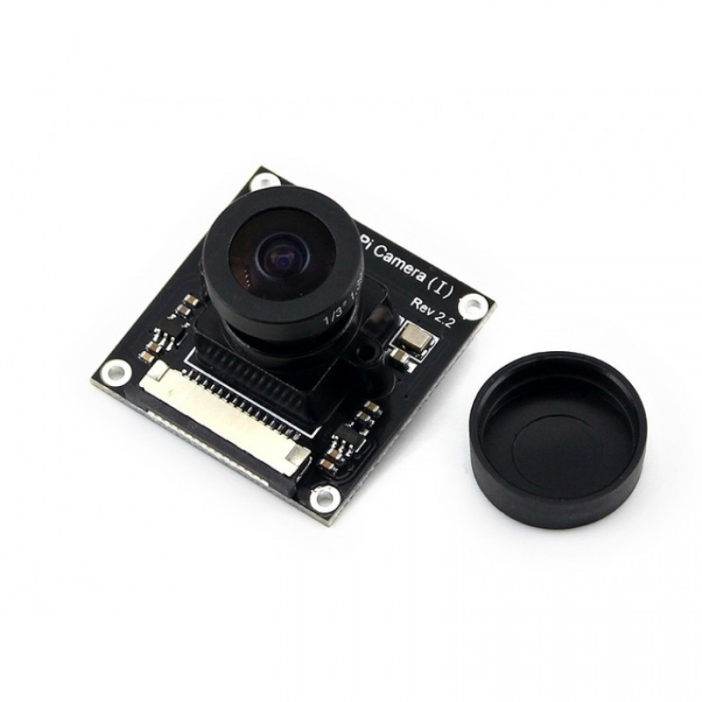
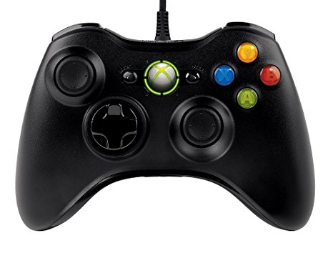
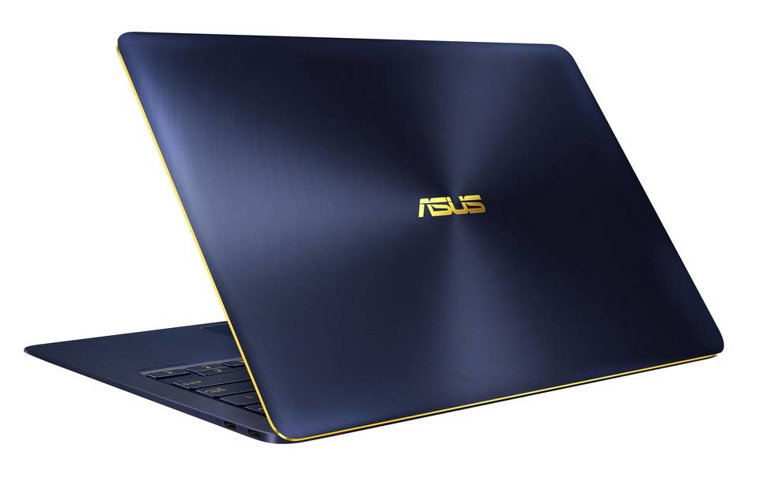
Data Generation Method
Record current image with associated angle/speed
Send receive controller motion control
Send joystick
and trigger keys
Client
(Computer)
Server
(Raspberry)
Controller
(User)
Camera
(Embedded)
Perform motion commands
and send ready token

Slide 7
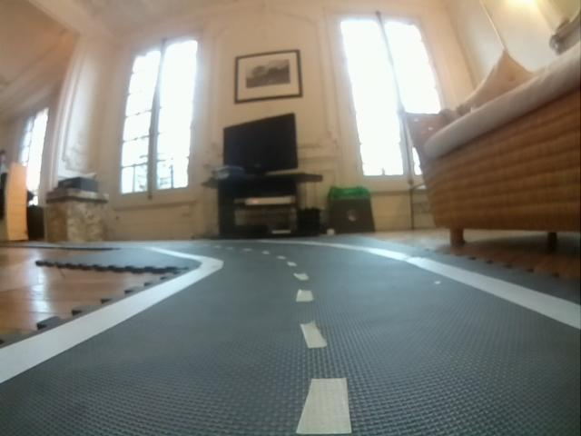
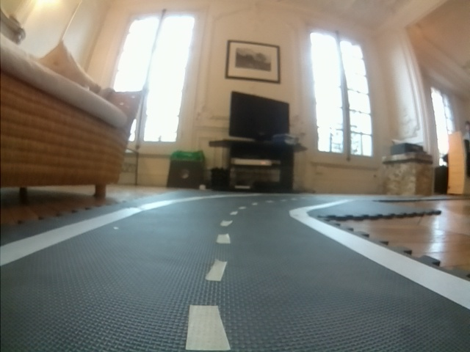

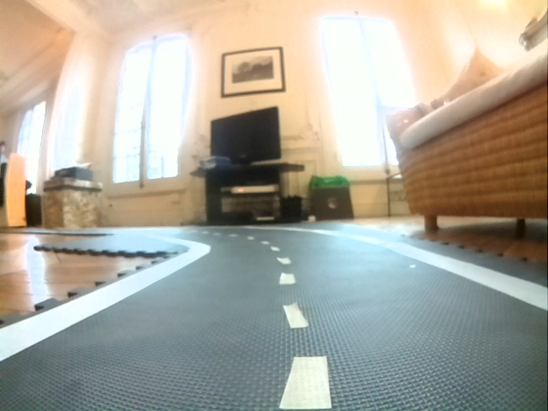
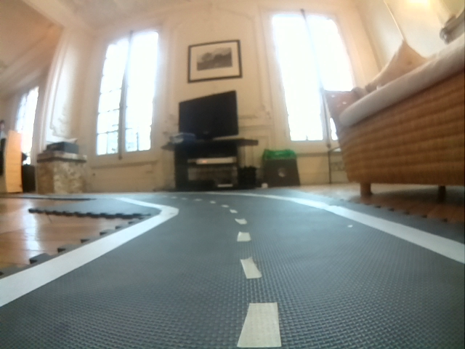
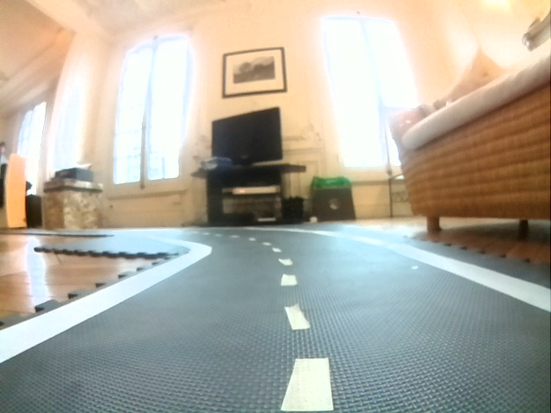
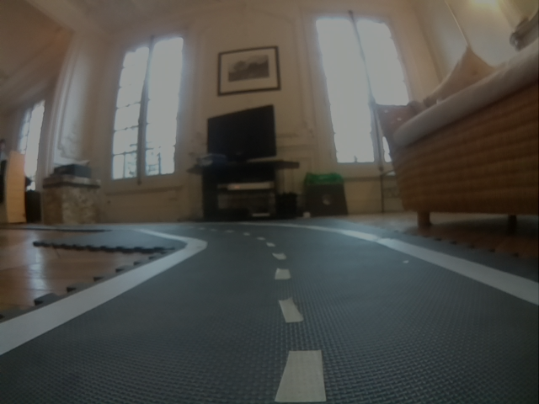

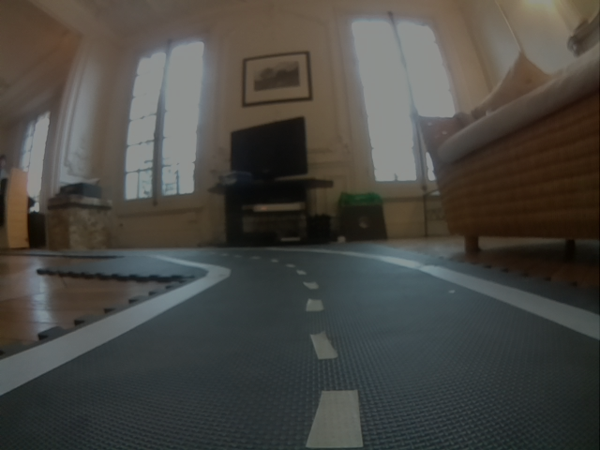
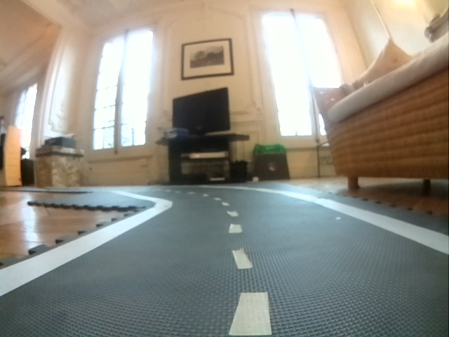



Data Augmentation
Flip Image
Random brightness generation on original and flipped images
Original
angle_label = -1
Flipped
angle_label = 1

Slide 8
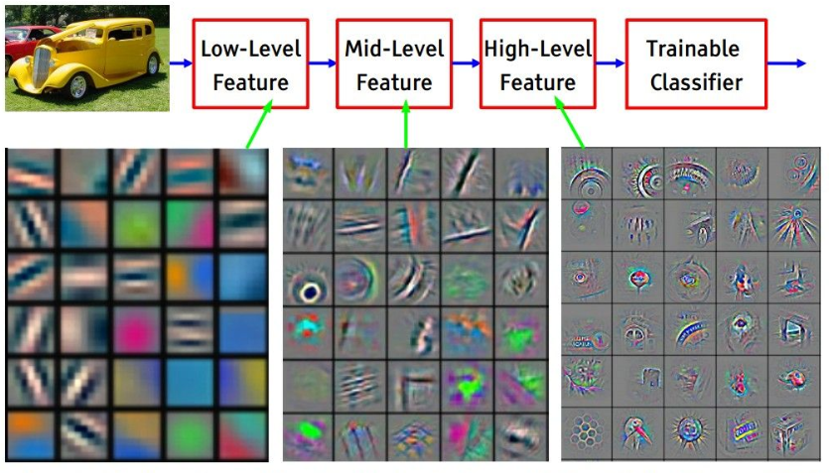
Why CNN ?
Pros :
Invariant in translation
Can analyze from small to high patterns
State of the art in computer vision
Cons :
Need a lot of data

Slide 9
Model Architecture
Convolution(8, mask =(3,3), strides=(2,2))
MaxPooling2D
Convolution(16, mask =(3,3), strides=(2,2))
MaxPooling2D
Light enough for real-time prediction on raspberry
Good performance
Convolution(32 mask =(3,3), strides=(2,2))
MaxPooling2D
GlobalAveragePooling2D()
Dense(32, activation=’relu’)
Dropout(0.1)
BatchNorm
Dense(2, activation=’sigmoid’)

Slide 10
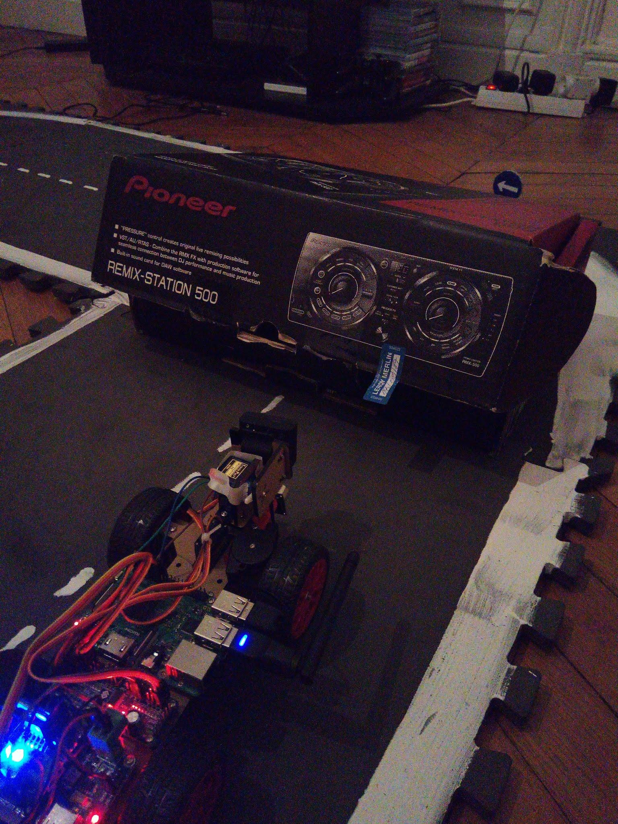
Obstacle Detection
Ultrasonic sensor
Range of 1 m
Stop in front of obstacles

Slide 11
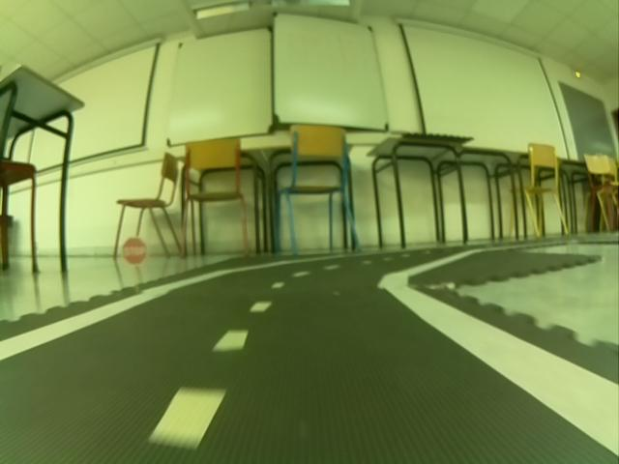

Sign Detection
Need to detect boxes of the sign in the image
Same model as angle/speed detection

Slide 12
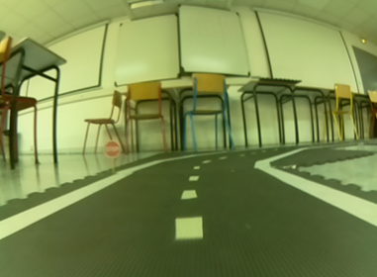
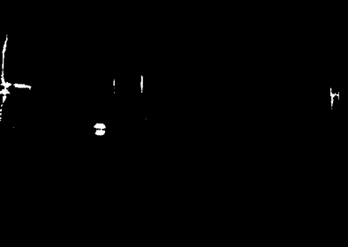
Box Detection Method
Hough transform:
common method for circle detection
not for real time
Hand-made method:
edge detection
try to fit circle
predict with the sign classifier

Slide 13




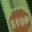










Sign Dataset
Random flip
Random scale
Random shift
Random brightness

Slide 14
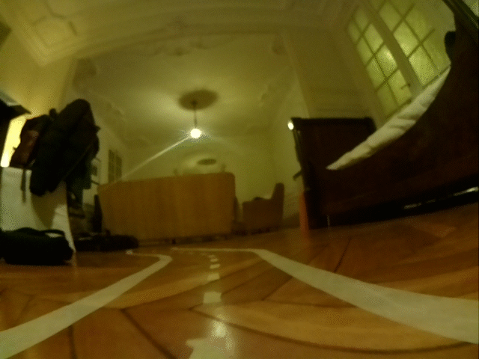
Driving Demo

Slide 15
Intersections management
Improve computing power - Donkey Car
Movidius - Inception
LSTM
Improvement tracks

Slide 16
Contact
Thibaut Barroyer
Axel Mendoza
thibaut.barroyer@epita.fr
axel.mendoza@epita.fr

Slide 17
THANKS!
ANY QUESTIONS?

